Slide 1
Ride Share Analysis
MSCA 37014 2 Python for Analytics
Spring 2023
Team#10 Zeyu Chen - Hyojun Kim - Prathik Nair - Alexander Saucedo

Slide 2

Agenda
Business Problem
Approach
EDA
Key Findings
Key Statistics
Summary
Next Step

Slide 3
Uber/Lyft Business Problems
The challenge of balancing supply and demand
To ensure there are enough drivers to meet demand
To attract new drivers and retain current drivers
Target:
Analyze descriptive statistics to derive data-driven solutions
Verify the most popular car brand and color variations
Check popular season by analyzing patterns of seasonality
Single Ride Share Driver vs Multi-rideshare Drivers

Slide 4
Approach to the Business Problem
Rideshare companies use dynamic pricing algorithms to adjust their fares based on demand/supply, incentivizing more drivers.
With the criterion:
Understand the behavior of riders to bring effective strategies
Attempt to allocate more resources of rides to provide safety
Ultimately, increase the number of rides to generate more earnings
Notes:
To better allocate Uber/Lyft Drivers,
This is sufficient enough to generate more earnings for rideshare companies

Slide 5
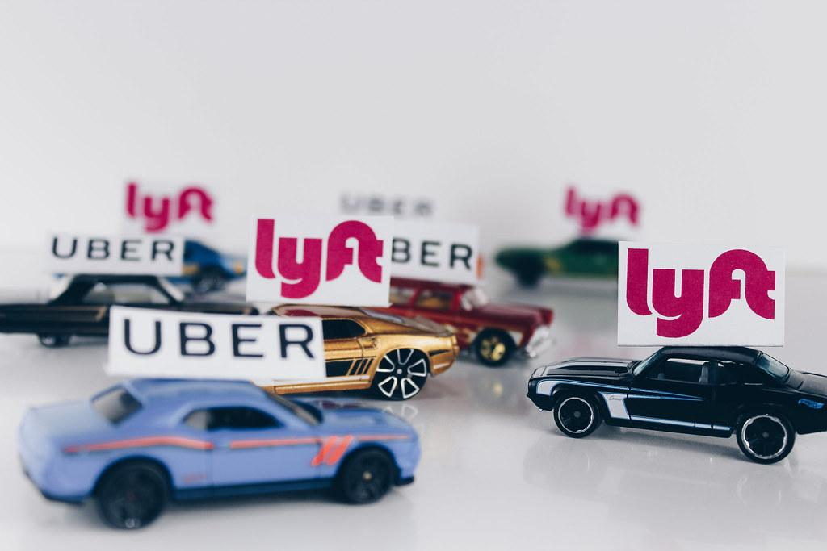
Dataset - Overview
8.84m Ride Records
Dates: Mar 2015 - Dec 2022
Car Years: 2000-2023
Car Makes: 57
Car Colors: 85
https://data.cityofchicago.org/Transportation/Transportation-Network-Providers-Vehicles/bc6b-sq4u

Slide 6
Dataset - Preparation
NaN Records - Filled with Mean or removed.
Normalization - Color, Make, and Model contained variations.
Feature Engineering -
Month Trip as MM from Month Reported as YYYY-MM
Month Inspection as MM from Month Reported as YYYY-MM
Duration as difference in time between Month Reported and Inspection

Slide 7
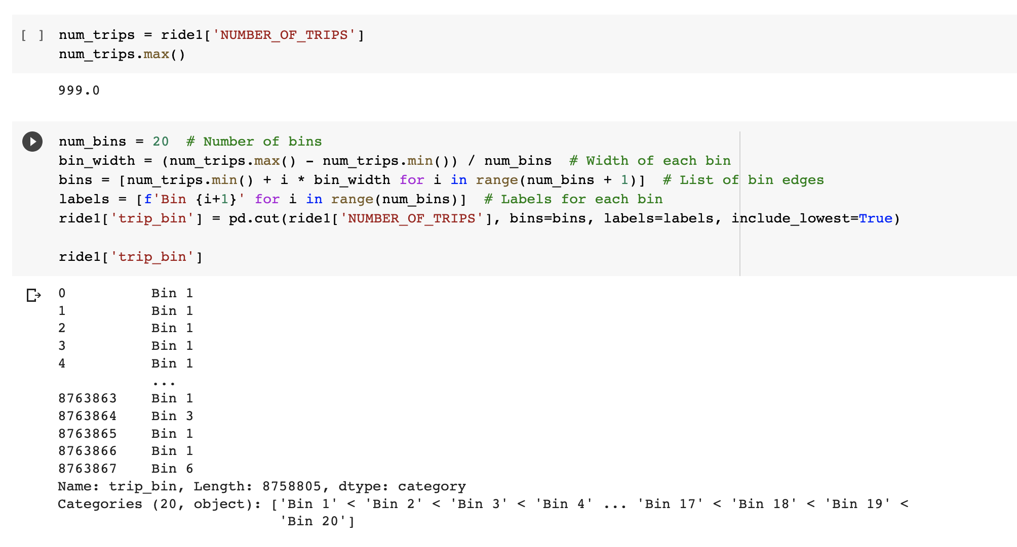
Discretize Number of Trips
Although we believed the 0’s in the distribution can be dealt by distributions, we considered the options of equal width bins for the number of distributions to reduce complexity.
We select 20 bins for this data with 50 as the width.

Slide 8
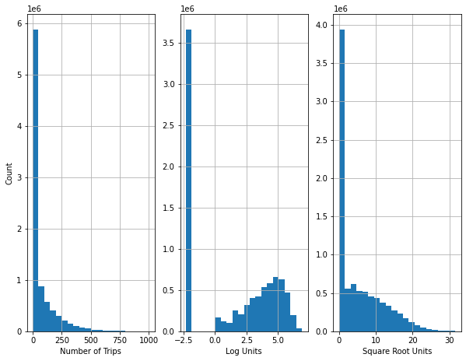
Number of Trips and Transformations
0 trip in a month is potentially caused by riders who consider rideshare as part time jobs.
After Log transformation, the distributions of trips larger than 0 seems to have a more normal distribution than before.
The square root distribution has the characteristics of a Tweedie distribution.

Slide 9
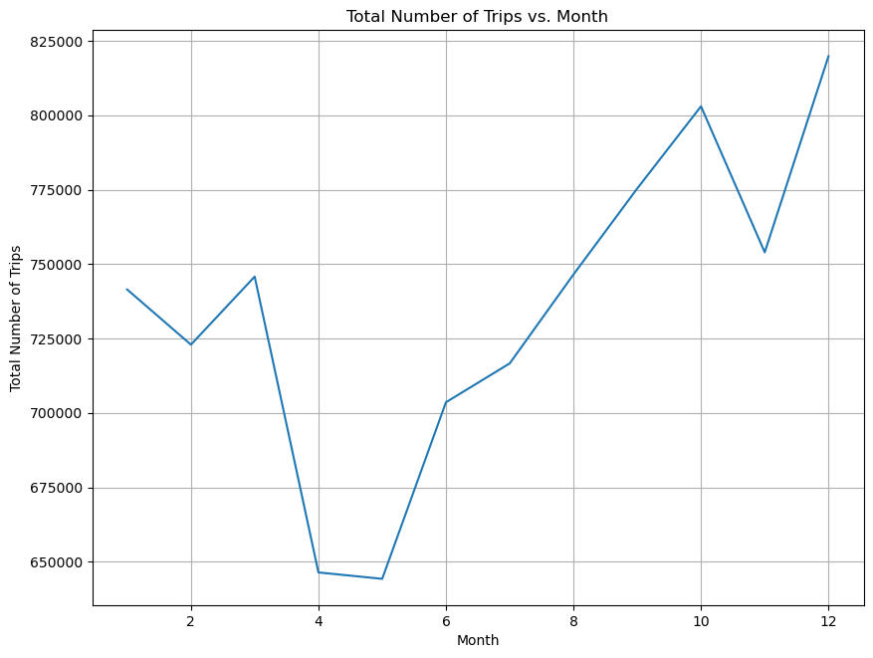
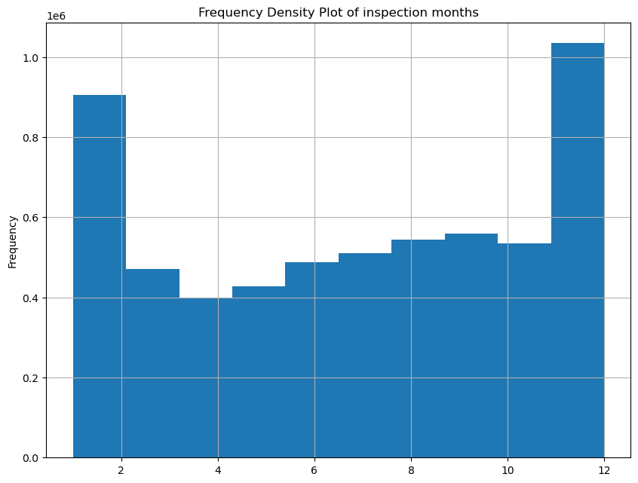
Rides & Inspections Distributions

Slide 10
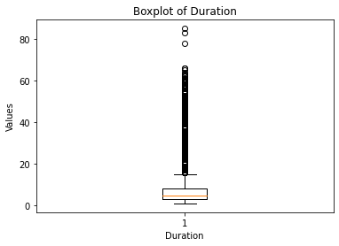
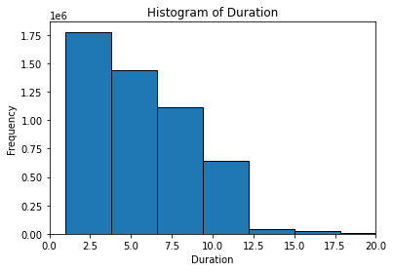
Distribution of Duration (Inspection)
Duration is the difference between the month reported and the last inspection month of the vehicle
The distribution seems to be heavily right skewed with many outliers.
The median duration of the data is 5 months.
Most of the drivers inspect their vehicles at least once a year.
Incentives can be considered to increase the drivers’ willingness to inspect their cars more often and increase security.

Slide 11
Dataset - Key Statistics
Avg Monthly Rides for Single Rideshare Drivers: 56
Avg Monthly Rides for Multi Rideshare Drivers: 145
Most Popular Car Make: Toyota (29% of total rides)
Most Popular Car Color: Black (29% of total rides)
Most Popular Month for Rideshare: December (9% of total rides)

Slide 12
Key Findings
Single rideshare drivers give an average of 56 monthly rides, whereas multi-rideshare drivers give an average of 145 monthly rides. This suggests that multi-rideshare drivers are more active and are likely using ridesharing as their primary source of income.
The most popular car make for rideshare drivers is Toyota, accounting for 29% of total rides. This may be due to the fact that Toyota is known for producing reliable and fuel-efficient cars that are well-suited for rideshare driving.
The most popular car color for rideshare drivers is black, accounting for 29% of total rides. This may be because black cars are perceived as more professional and luxurious, which may be appealing to rideshare passengers.
December is the most popular month for rideshare, accounting for 9% of total rides. This could be due to increased demand for rides during the holiday season, as people travel more to see family and friends, attend parties and events, and do holiday shopping.

Slide 13
Key Findings
The most common ride distance is between 2 and 3 miles, representing 33% of all rides.
The average distance per ride is 4.7 miles.
The most common hour for rides is 5 PM, representing 6% of all rides.
The majority of rides (70%) are completed within 30 minutes.
On average, rideshare drivers earn $14.25 per hour, assuming they work for 8 hours per day and take 20 days off per year.

Slide 14
Summary
We obtained rideshare dataset with 8 million records to prepare and analyze the market of rideshare in Chicago that includes the behavior of the riders to understand the current market.
We discovered that rideshare amount exists a seasonality trends, which relate to temperature and weather.
Toyota being the most popular brand and black cars being the most prominent colors suggest that price and fuel efficiency are influential factors for riders to consider.
People tend to choose rideshares for short distance travel - avg 4.7 miles.

Slide 15
Next Step
Analysis:
We would like to collect more information and data on traveling time, costs to evaluate the change in cost vs. the volume of waiting.
We would like to use data to discover relationship between weather, cost and traffic volumes, and create predictive models for riders to better allocate resources.
Business:
With the information we obtained from existing riders, build collaboration with brands such as Toyota to create assistance programs to better assists riders.
Initiate campaign regarding car inspection every year to raise awareness of traffic safety to build a better brand image.

Slide 16
Thank you
Team #10
Zeyu Chen - Hyojun Kim - Prathik Nair - Alexander Saucedo

